Slide 1

Power BI
- ADITHYAN B
25MIB003

Slide 2
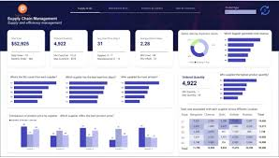
INTRODUCTION TO POWER BI
Power BI's software services, applications, and connectors can transform your unprocessed data into engaging and dynamic visual insights.
The objective is to promote data-driven decision-making by assisting you in connecting to various data sources, visualizing that data, and sharing the ensuing insights (such as dashboards and reports) throughout your company.
The procedure involves cleaning and modeling data (from databases, cloud services, Excel, etc.) before presenting it in reports and dashboards that are simple to comprehend.

Slide 3
Common Power BI Workflow
When a business analyst uses Power BI, the typical workflow is as follows:
Obtain Data: Use Power BI Desktop to establish a connection to your data sources (Excel, SQL, CSV, etc.).
Transform Data: Use the Power Query Editor to clean, combine, and shape the data. ETL (Extract, Transform, Load) is a common term for this.
Model Data: Use a formula language called DAX (Data Analysis Expressions) to write custom calculations and establish links between your data tables.
Visualize and Report: In Power BI Desktop, drag and drop fields to make tables, charts, and maps on a report canvas.
Publish & Share: To share the completed report with coworkers and arrange it into a dashboard, upload it to the Power BI Service.

Slide 4
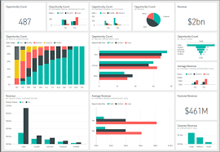
The Role of a Target Column
A target column's primary use is to make performance tracking and variance analysis easier. It enables users to rapidly determine whether the actual outcomes are better or worse than anticipated.

Slide 5
POWER BI
TOPICS DASHBOARD!!
DATASET REGARDING CARS BRANDS DETAILS (DATA CLEANING , DATA MODELING & DATA VISUALIZATION)
01
DATASET REGARDING MUSIC ARTIST (DATA CLEANING , DATA MODELING & VISUALIZATION)
02

Slide 6
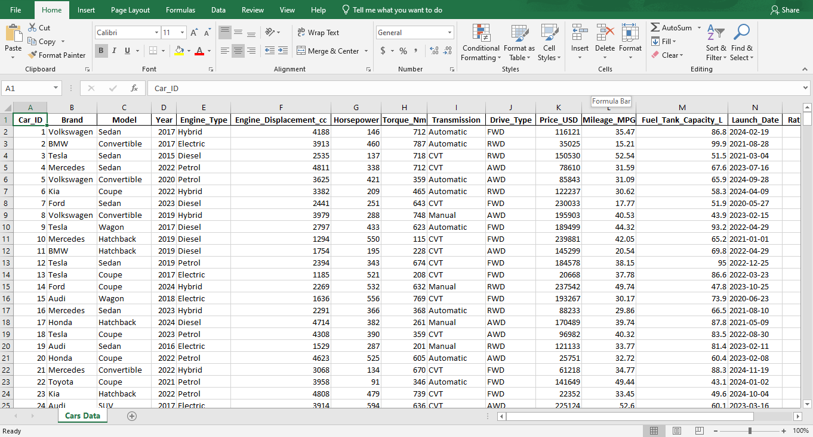
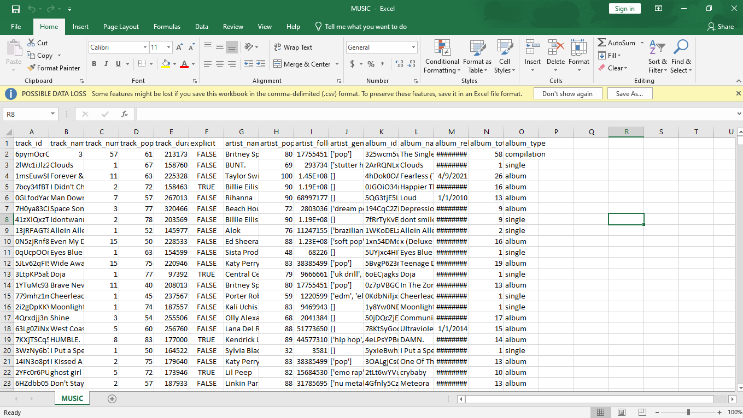
EXCEL SHEETS USED AS DATASET
CAR BRANDS DETAILS
MUSIC ARTIST

Slide 7
DATASET REGARDING CARS BRAND DETAILS (DATA CLEANING , DATA MODELING & DATA VISUALIZATION)

Slide 8
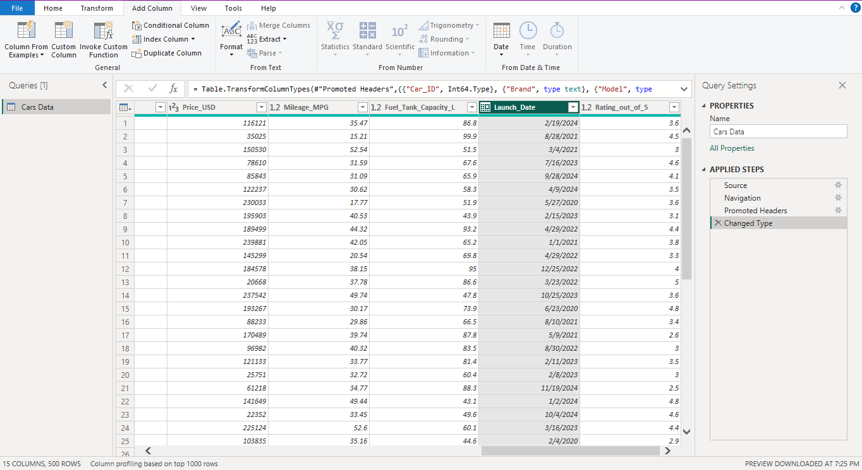
DATASET OF CAR BRAND DETAILS
SCREEN SHOT OF DATASET USED TO CREATE DATASET

Slide 9
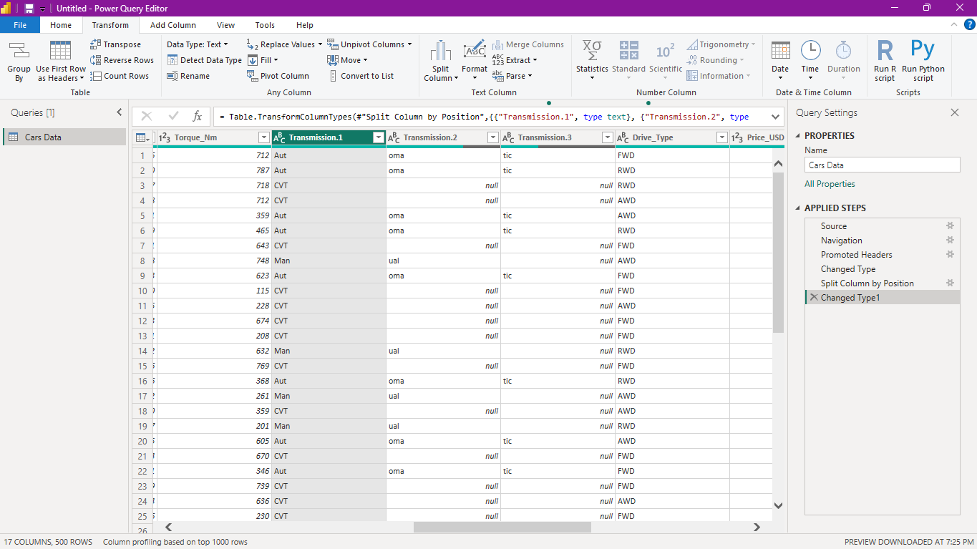
SPLIT COLUMN
Split the column according to position, character length, and delimiter.
From lowercase to uppercase and vice versa -VERSA
Digital to non-digital and vice versa

Slide 10
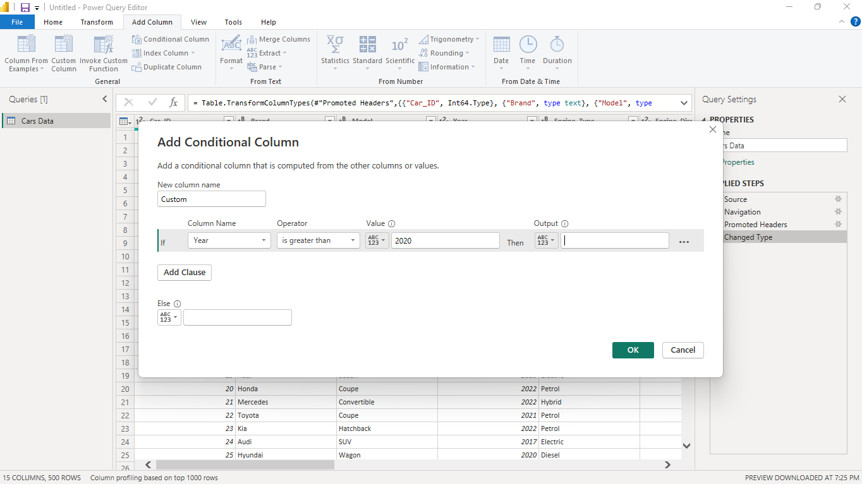
CONDITION COLUMN
During data transformation, you can use Power BI's Conditional Column tool to generate a new column based on IF/THEN/ELSE logic applied to the values of other columns in your table.

Slide 11
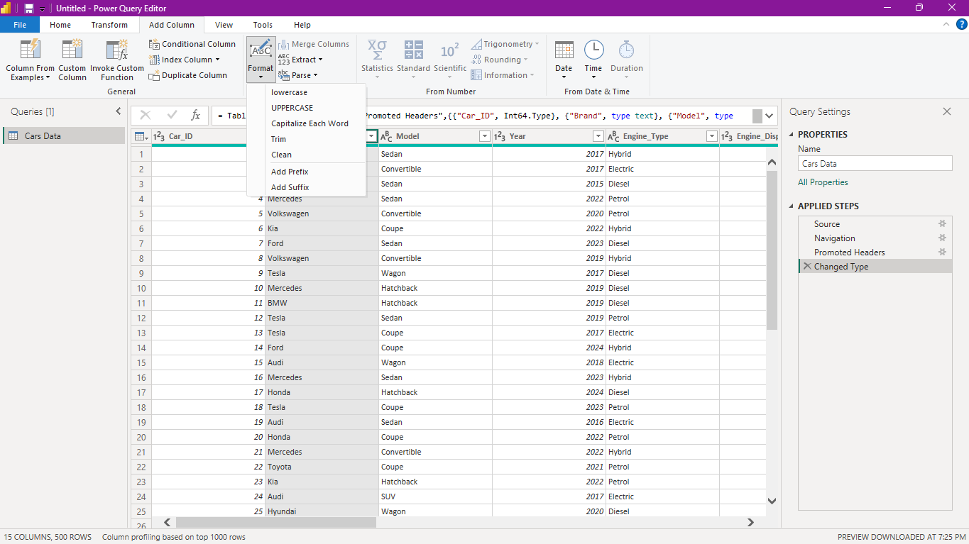
FORMAT
FORMAT AIDS IN ADDING NEW COLUMNS OR MODIFYING EXISTING COLUMNS WITH FEATURES LIKE UPPERCASE,LOWERCASE,CAPITALIZE, TRIM, CLEAN & PREFIX &SUFFIX

Slide 12
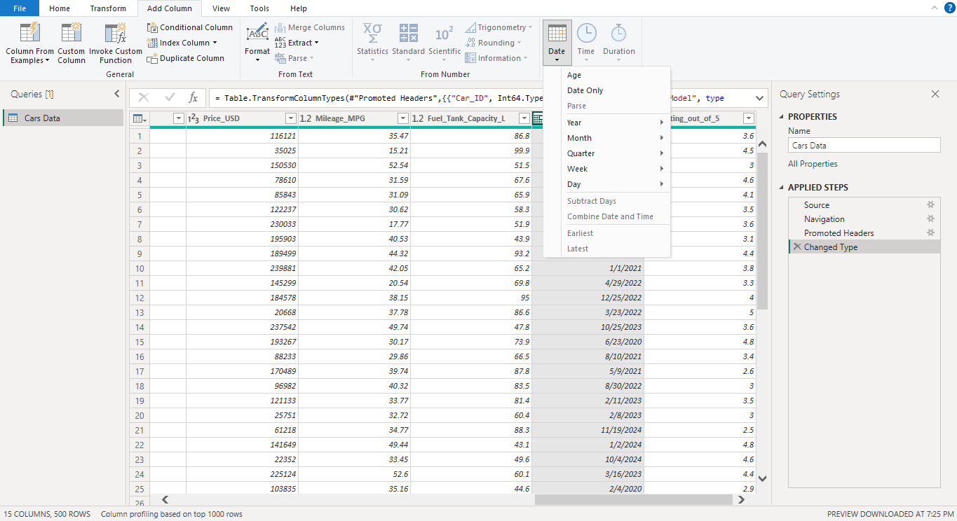
DATE FUNCTION
DATE FUNCTIONS ARE BEING USED TO CATAGORIZE THE DATE INTO YEAR,MONTH,WEEK,
QUARTER,DAY OR IN TERMS OF AGE

Slide 13
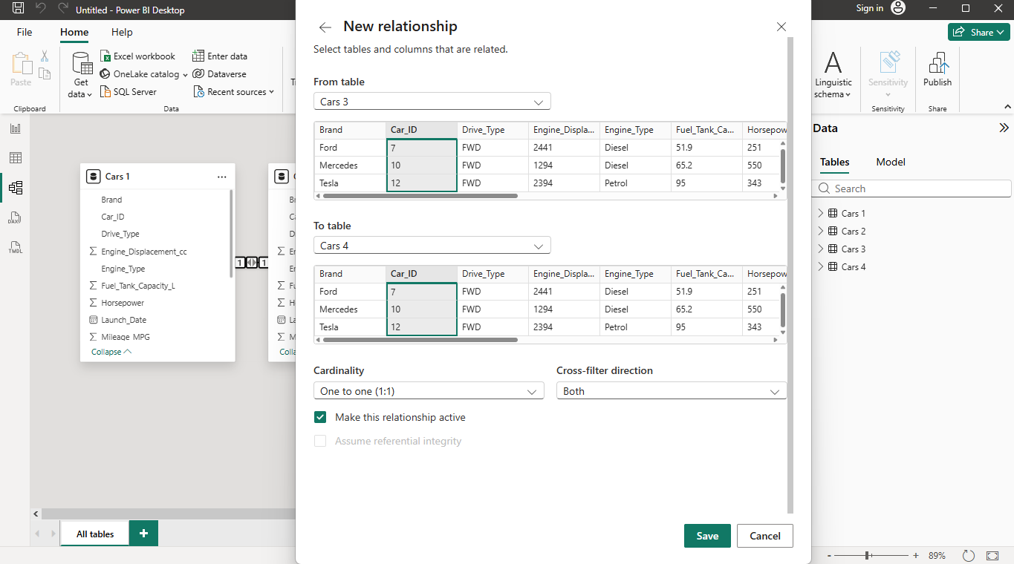
CREATING RELATION
CREATING NEW RELATIONSHIP HELP TO CREATE A LINK BETWEEN TWO TABLES OR MORE.
ONE TO ONE
ONE TO MANY
MANY TO MANY
MANY TO ONE

Slide 14
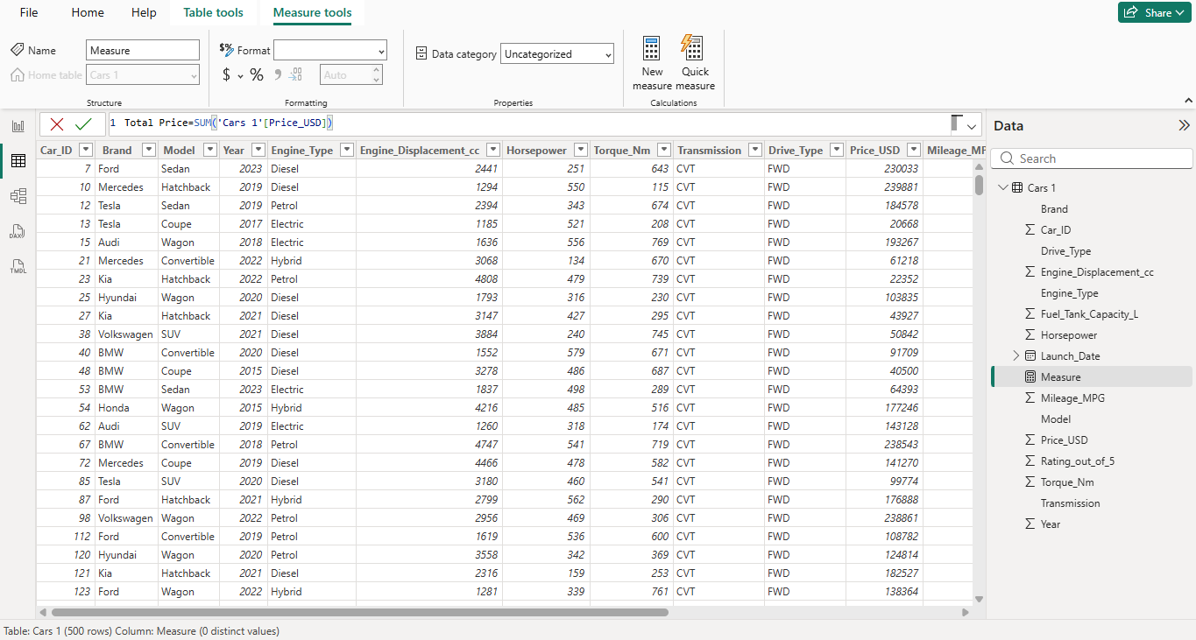
SUM FUNCTION
SUM FUNCTION HELPS IN MAKLING A MATHEMATICS EXPRESSION SUCH AS ADDITION USED IN CLOUMN WITH NUMERIC CONTEXT

Slide 15
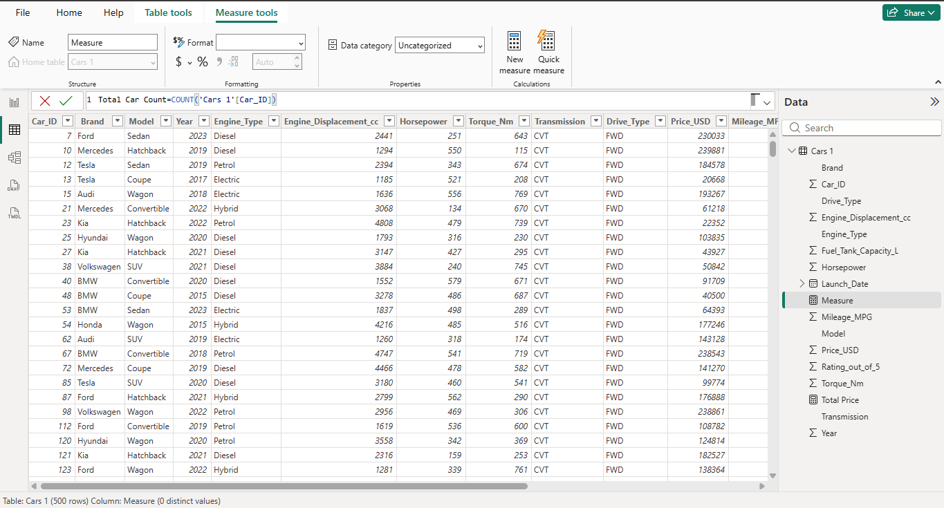
COUNT FUNCTION
COUNT FUNCTION HELP IN FINDING TOTAL NUMBERS OF ROWS IN THE DATASET.
COUNT FUNCTION HAVE A SUB VARIENT NAMED DISTINCT COUNT HELPED TO COUNT THE NUMBER OF COLUMNS BY ELEMINATING DUPLICATE VALUES

Slide 16
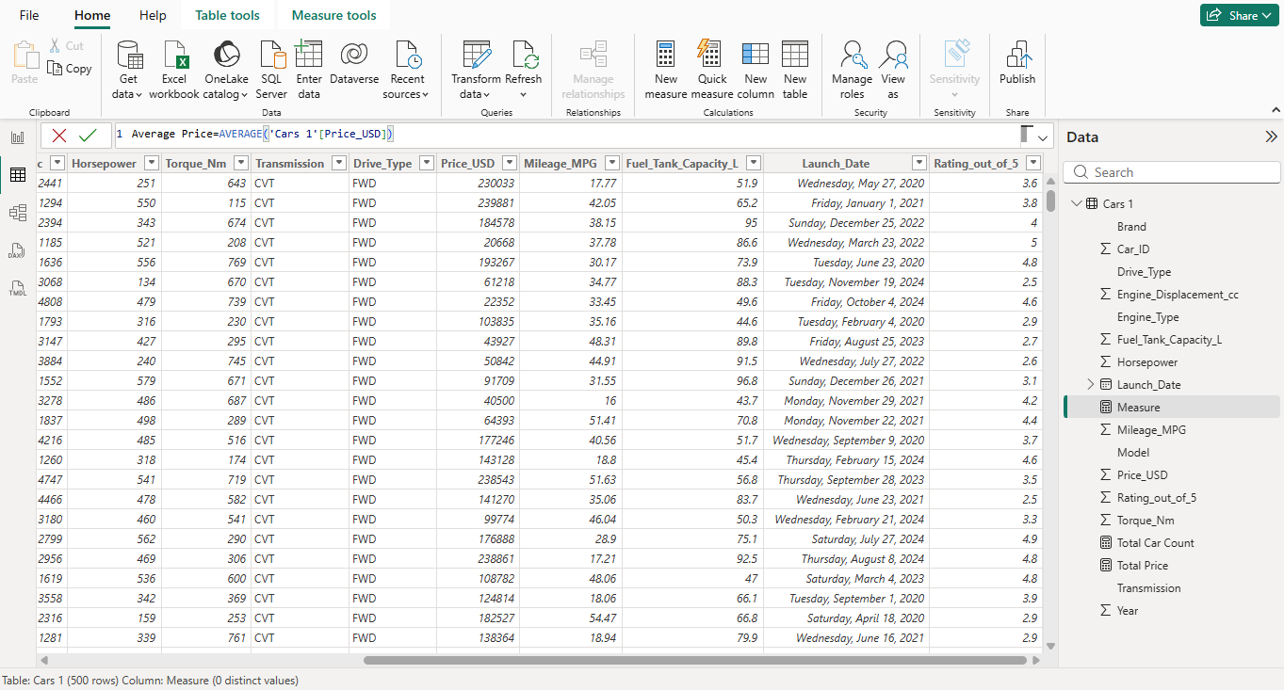
AVERAGE FUNCTION
AVERAGE FUNCTION IS BEEN USED TO FIND THE AVERAGE OF THE NUMERIC DATACOLUMN
USES FORMULA :
TOTAL OF DATA OR ELEMENTS / NO OF ELEMENTS

Slide 17
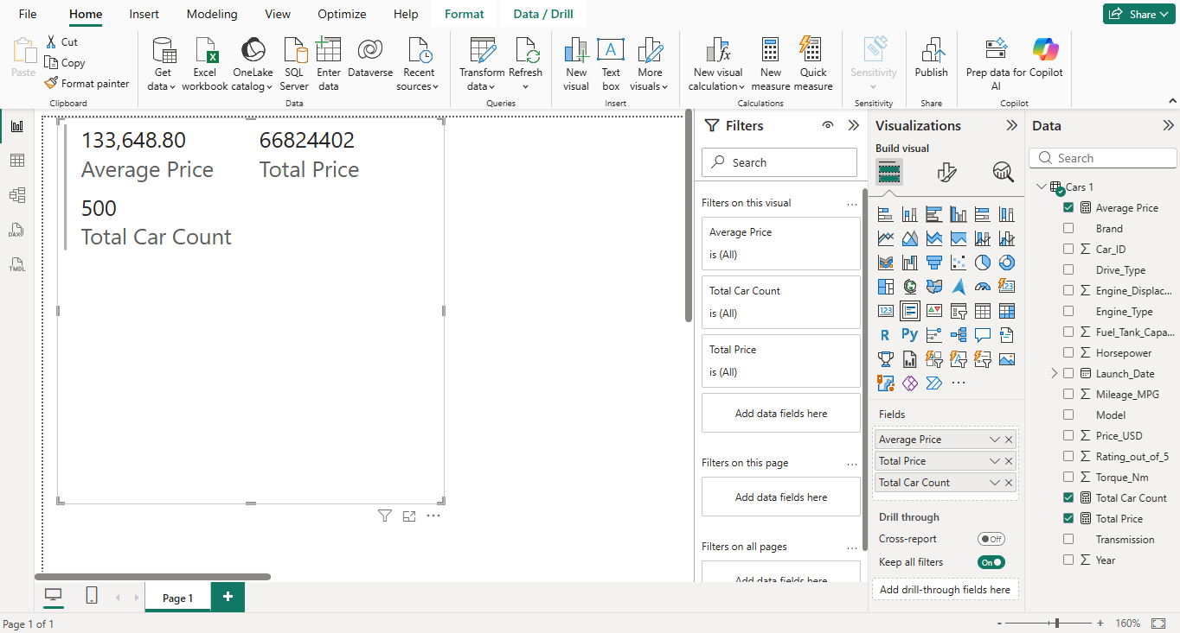
REPORT VIEW

Slide 18
THANK YOU

